Slide 1

HOTEL AGGREGATOR ANALYSIS
Harsh Gotecha
Mentorness

Slide 2
Table of contents
01
INTRODUCTION
04
HOST PERFORMANCE
02
GEOGRAPHICAL INSIGHTS
05
REVIEW SCORES AND GUEST SATISFACTION
03
PRICING AND AVAILABILITY ANALYSIS
06
PROPERTY TYPE AND ROOM ANALYSIS
02

Slide 3
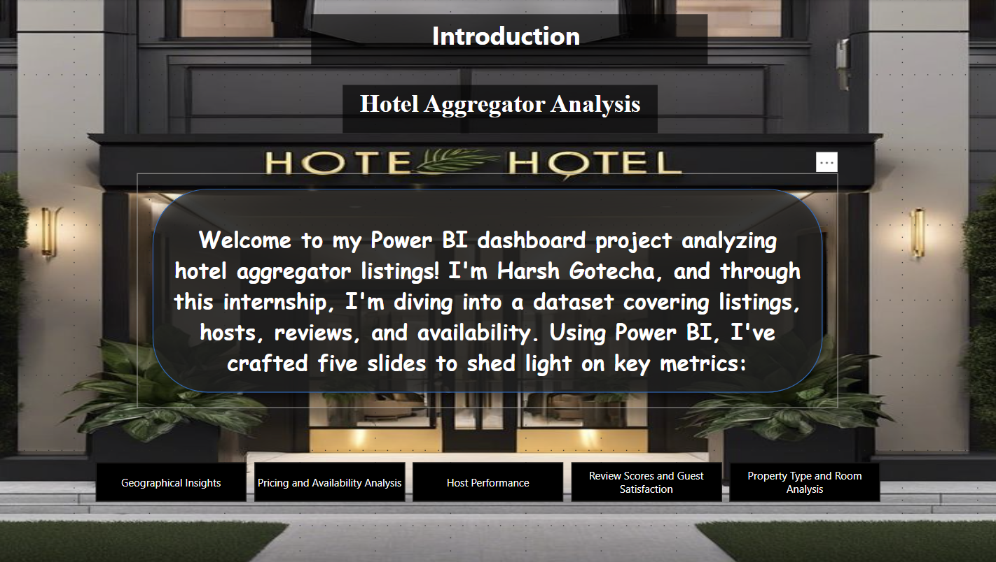
Introduction
03

Slide 4
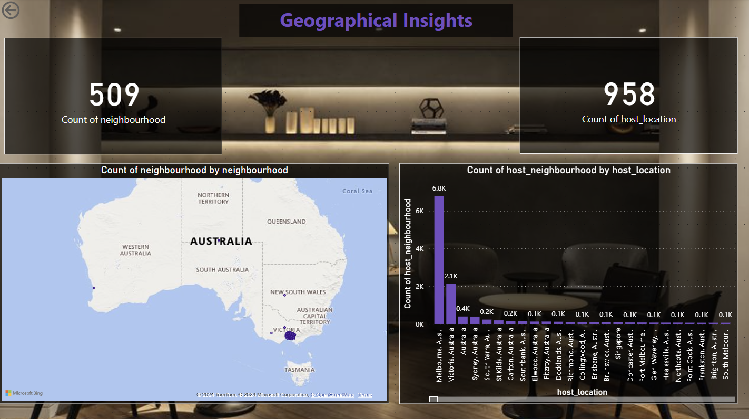
Geographical Insights
04

Slide 5
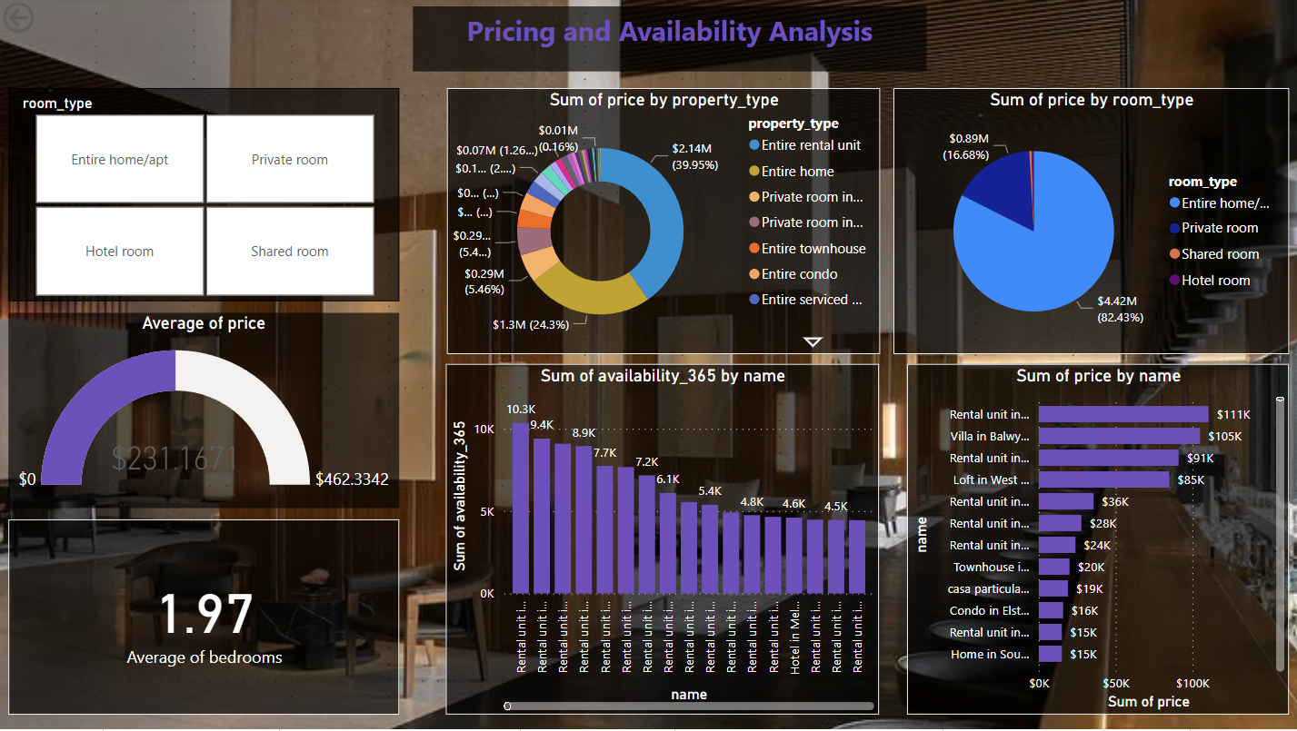
Pricing and Availability Analysis
05

Slide 6
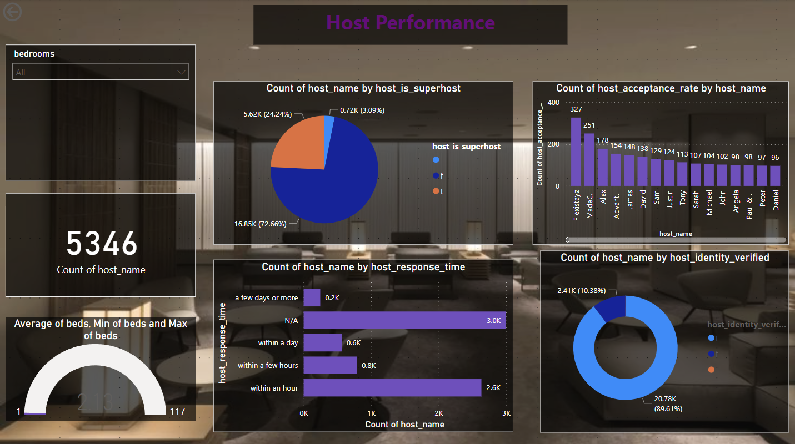
Host Performance
06

Slide 7
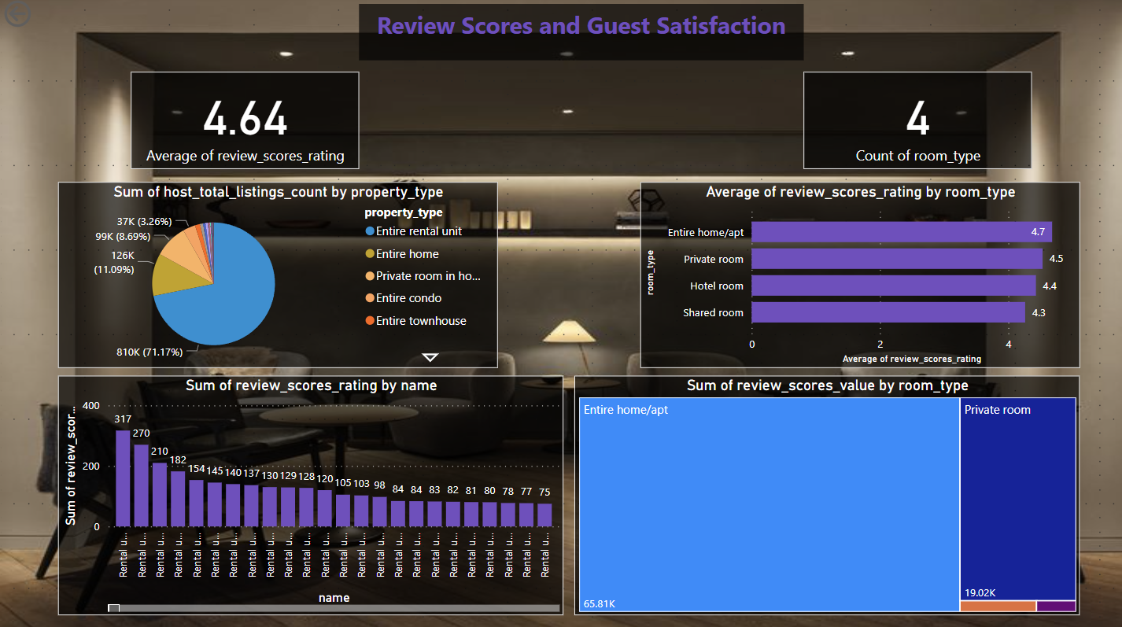
Review Scores and Guest Satisfaction
07

Slide 8
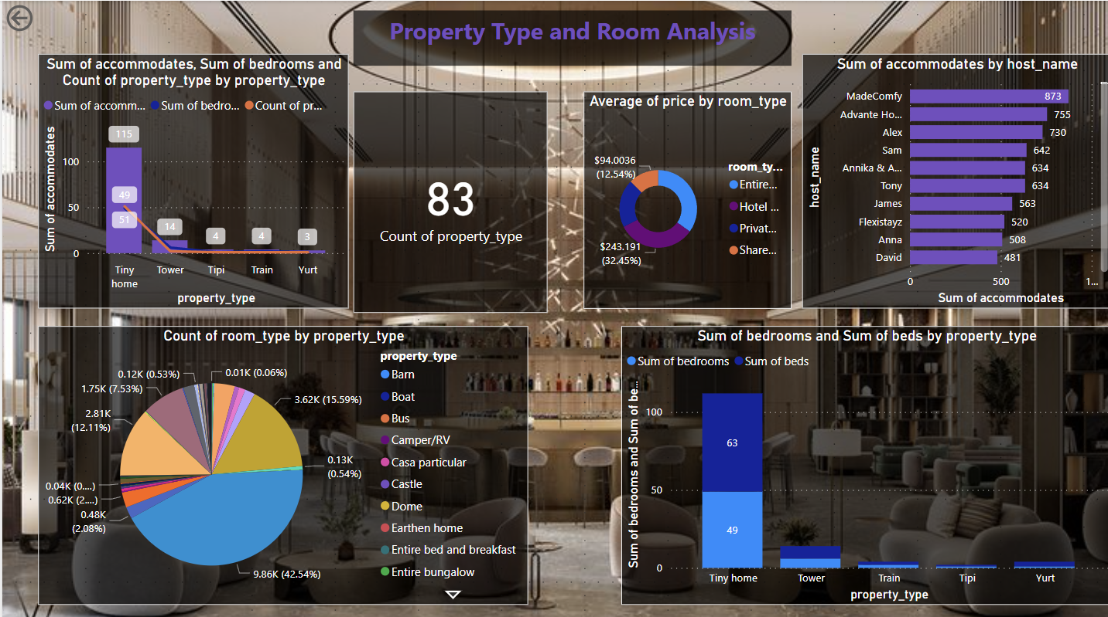
Property Type and Room Analysis
08

Slide 9

Thank You

